Slide 1
Introduction to JSR 354 Money & Currency
Anatole Tresch
atsticks@java.net @atsticks
http://java.net/projects/javamoney

Slide 2
Bio
Anatole Tresch
Introduction to JSR 354
http://java.net/projects/javamoney
Anatole Tresch
  Consultant - Coach
  Java since 1.0
  Open Source Addicted
  Lead Enginner, Framework Architect Credit Suisse
  Specification Lead, JSR 354

Slide 3
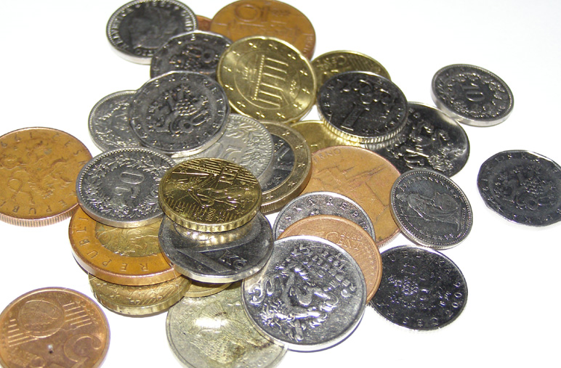
Agenda
Anatole Tresch
Introduction to JSR 354
http://java.net/projects/javamoney
History and Motivation
Overview
Currencies and Amounts
Precision and Rounding
Formatting and Parsing
Currency Conversion
Currency Services and Extensions
Extras
Demo
Platform (SE) Scope¹
Standalone Scope
¹ See http://mreinhold.org/blog/secure-the-train
SE scope may no longer be part of Money API 1.0

Slide 4
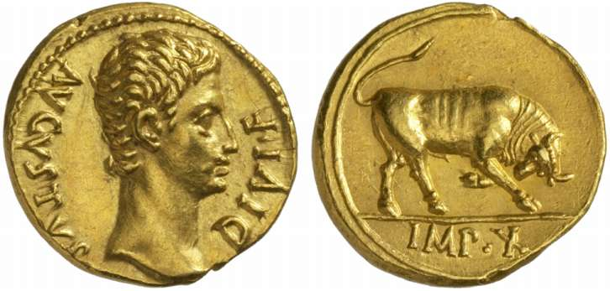
History and Motivation
Anatole Tresch
Introduction to JSR 354
http://java.net/projects/javamoney

Slide 5
Earlier Approaches
Anatole Tresch
Introduction to JSR 354
http://java.net/projects/javamoney
Martin Fowler:
A large proportion of the computers in this world manipulate money, so it’s always puzzled me that money isn’t actually a first class data type in any mainstream programming language. The lack of a type causes problems, the most obvious surrounding currencies…
see http://martinfowler.com/eaaCatalog/money.html
Eric Evans – Time and Money:
On project after project, software developers have to reinvent the wheel, creating objects for simple recurring concepts such as “money” and “currency”. Although most languages have a “date” or “time” object, these are rudimentary, and do not cover many needs, such as recurring sequences of time, durations of time, or intervals of time. …
To be quite frank, their code isn’t more than an academic POC, factories called dollars() or euros() are useless in real globally deployed frameworks, but he made a good point.

Slide 6
Motivation
Anatole Tresch
Introduction to JSR 354
http://java.net/projects/javamoney
Monetary values are a key feature to many applications
Existing java.util.Currency class is strictly a structure used for representing ISO-4217 standard currencies.
No standard value type to represent a monetary amount
No support for currency arithmetic or conversion
JDK Formatting features lack of flexibility

Slide 7

Schedule
Anatole Tresch
Introduction to JSR 354
http://java.net/projects/javamoney
Standalone JSR
EDR started 1st May 2013
Java ME/Embedded 8 oder 9
Following the EC Merge and Standard/Embedded harmonization, no JSR should be SE/EE or ME only. Money is so important, and has almost no legacy in the JDK except java.util.Currency, that it should be supported by all possible platforms, except maybe JavaCard for now.
Minimum Java Version: 7 (given, 8 won’t be here until 2014)
with reasonable support of previous Java versions
still relevant (e.g. Java 6)
Java SE 9: Early 2016
  Either a Maintenance Release or new version
  of this JSR shall be integrated with
  OpenJDK 9.

Slide 8
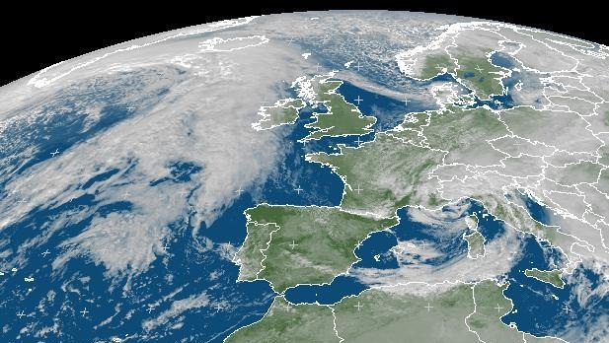
Overview
Anatole Tresch
Introduction to JSR 354
http://java.net/projects/javamoney

Slide 9
Overview about JSR 354
Anatole Tresch
Introduction to JSR 354
http://java.net/projects/javamoney
Core API: javax.money
  CurrencyUnit, MonetaryAmount and exceptions
Conversion API: javax.money.conversion
  ExchangeRate, ConversionProvider, CurrencyConverter
Formatting: javax.money.format
  LocalizationStyle, ItemFormatter, ItemParser
Extensions: javax.money.ext
  Region support, compound values
  MonetaryCurrencies,…
Reference Implementation: net.java.javamoney.ri
TCK: net.java.javamoney.tck

Slide 10
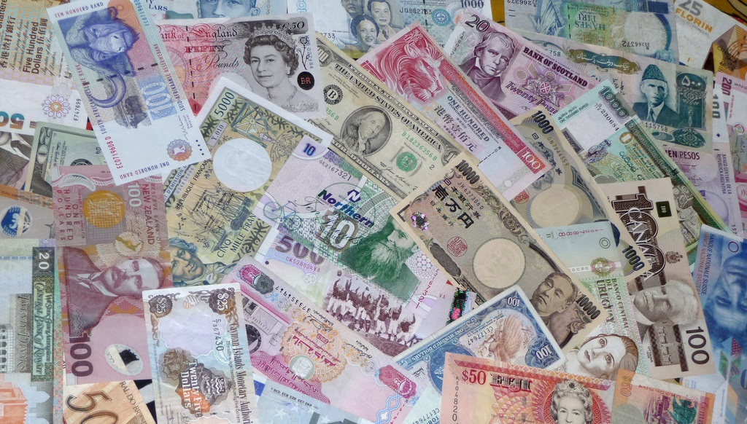
Currencies and Amounts (javax.money)
Anatole Tresch
Introduction to JSR 354
http://java.net/projects/javamoney

Slide 11
Currencies – ISO 4217
Anatole Tresch
Introduction to JSR 354
http://java.net/projects/javamoney
Special Codes
Ambiguities
Unmodeled Aspects
Minor units
  Precious Metals (XAU, XAG)
  Testing (XTS)
  No Currency (XXX)
  Supranational currencies, e.g. East Caribbean dollar, the CFP franc, the CFA franc.
  CFA franc: West African CFA franc und Central African CFA franc = denotes 2 effectively interchangeable (!).
  Switzerland: CHF, CHE (WIR-EURO), CHW (WIR)
  USA: USD, USN (next day), USS (same day)
  Legal acceptance, e.g. Indian Rupees are legally accepted in Buthan/Nepal, but not vice versa!
Typically 1/100, rarely 1/1000, but also 1/5 (Mauritania, Madagaskar), 0.00000001 (BitCoin)

Slide 12


Virtual Currencies
Anatole Tresch
Introduction to JSR 354
http://java.net/projects/javamoney
Video Game Currencies (Gold, Gil, Rupees, Credits, Gold Rings, Hearts, Zenny, Potch, Munny, Nuyen…)
Facebook Credits are a virtual currency you can use to buy
virtual goods in any games or apps of the Facebook
platform that accept payments. You can purchase
Facebook Credits directly from within an app using your
credit card, PayPal, mobile phone and many other local
payment methods.
Bitcoin (sign: BTC) is a decentralized digital currency
based on an open-source, peer-to-peer internet protocol.
It was introduced by a pseudonymous developer named
Satoshi Nakamoto in 2009.

Slide 13
Improve java.util.Currency
Anatole Tresch
Introduction to JSR 354
http://java.net/projects/javamoney
Current Limitations
No support for historical Currencies
No support for non standard Currencies
(e.g. cows or camels)
No support for virtual
Currencies (Lindon Dollars,
BitCoin, Social Currencies)
No support for custom
schemes (e.g. legacy codes)
Only access by currency
code, or Locale
No support for special use
cases/extensions
Implementation:
MoneyCurrency
public interface CurrencyUnit{
public String getCurrencyCode();
public int getNumericCode();
public int getDefaultFractionDigits();
// new methods
public String getNamespace();
public boolean isLegalTender();
public boolean isVirtual();
public Long getValidFrom();
public Long getValidUntil();
}
public interface Localizable{
public String getDisplayName(
Locale locale);
}

Slide 14
Access/Create Currencies - Usage
Anatole Tresch
Introduction to JSR 354
http://java.net/projects/javamoney
Accessing of an ISO Currency (backed up by JDK Currency)
MoneyCurrency currency1 = MoneyCurrency.of("USD");
Accessing a non ISO Currency :
CurrencyUnit currency2 = MoneyCurrency.of("myNamespace", "myCode");

Slide 15
Access/Create Currencies – Usage (continued)
Anatole Tresch
Introduction to JSR 354
http://java.net/projects/javamoney
Creation and registering a non ISO CurrencyUnit using a Builder
MoneyCurrency.Builder builder = new MoneyCurrency.Builder();
builder.setNamespace("myNamespace");
builder.setCurrencyCode("myCode");
builder.setDefaultFractionDigits(4);
builder.setLegalTender(false);
builder.setValidFrom(System.currentTimeMillis());
builder.setVirtual(true);
builder.setAttribute("test-only", true);
CurrencyUnit unit = builder.build();
// nevertheless MoneyCurrency.of("myNamespace", "myCode"); still returns
// null!
builder.build(true);
// no it is registered
unit = MoneyCurrency.of("myNamespace", "myCode");

Slide 16
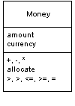

Monetary Amount
Anatole Tresch
Introduction to JSR 354
http://java.net/projects/javamoney
Amount = Number + Currency + Operations
How to represent the numeric amount?
Contradictory requirements:
  Performance (e.g. for trading)
  Precision and scale (e.g. for calculations)
  Must model small numbers (e.g. web shop)
  Must support large numbers (e.g. risk calculations, statistics)
  Rounding
  Financial operations and functions, function chaining
Solution:
support several numeric representations!
MonetaryFunction similar to java.function.Function
MonetaryOperator similar to java.function.UnaryOperator

Slide 17
Monetary Amount (continued)
Anatole Tresch
Introduction to JSR 354
http://java.net/projects/javamoney
public interface MonetaryAmount{
public CurrencyUnit getCurrency();
public Class<?> getNumberType();
public <T> T asType(Class<T>);
public int intValue(); public int intValueExact();
public long longValue(); public long longValueExact();
[…]
public MonetaryAmount abs();
public MonetaryAmount min(…);
public MonetaryAmount max(…);
public MonetaryAmount add(…);
public MonetaryAmount substract(…);
public MonetaryAmount divide(…);
public MonetaryAmount[] divideAndRemainder(…);
public MonetaryAmount divideToIntegralValue(…);
public MonetaryAmount remainder(…);
public MonetaryAmount multiply(…);
public MonetaryAmount withAmount(Number amount);
[…]
public int getScale(); public int getPrecision();
[…]
public boolean isPositive(); public boolean isPositiveOrZero();
public boolean isNegative(); public boolean isNegativeOrZero();
public boolean isLessThan(…);
public boolean isLessThanOrEqualTo(…);
[…]
public MonetaryAmount with(MonetaryOperator op);
}
Data Access.
Algorithmic
Operations…
Data Representation
and Comparison.

Slide 18
Monetary Function, Monetary Operator
Anatole Tresch
Introduction to JSR 354
http://java.net/projects/javamoney
Implementations:
//@FunctionalInterface for Java 9
public interface MonetaryFunction<T, R> {
public R apply(T value);
}
Minimum
Maximum
Average
Total
SeparateAmounts
SeparateCurrencies
Implementations:
//@FunctionalInterface for Java 9
public interface MonetaryOperator
extends MonetaryFunction<MonetaryAmount,MonetaryAmount>{
}
CurrencyConversion
MonetaryRounding
Reciprocal
MinorPart
MajorPart

Slide 19
Creating Amounts - Usage
Anatole Tresch
Introduction to JSR 354
http://java.net/projects/javamoney
Create an amount with an ISO currency
MonetaryAmount amount = Money.of("USD", 1234566.15);
// using ISO namespace by default
Create an amount using a custom currency
CurrencyUnit currency = MoneyCurrency.of("myNamespace", "myCode");
MonetaryAmount amount = Money.of(currency, 1234566.15);

Slide 20

Precision and Rounding – javax.money
Anatole Tresch
Introduction to JSR 354
http://java.net/projects/javamoney

Slide 21
Numeric Precision
Anatole Tresch
Introduction to JSR 354
http://java.net/projects/javamoney
Internal Precision (implied by internal number type)
External Precision (Rounding applied, when the numeric part is accessed/passed outside)
Formatting Precision (Rounding for display and output)
Interoperability
  Different precision/scale
  Distinct numeric representations
  Include on Serialization
By default
only internal rounding is applied automatically.
the precision/scale capabilities of an MonetaryAmount are inherited to its operational results.

Slide 22
Mixing Numeric Representations
Anatole Tresch
Introduction to JSR 354
http://java.net/projects/javamoney
Money amt1 = Money.of(“CHF”, 10.23d);
IntegralMoney amt2 = IntegralMoney.of(“CHF”, 123456789);
MonetaryAmount result = amt1.add(amt2);
// returns Money instance, since its the class on which
// add() was called.
Mechanism applies similarly for operation chaining
Money amt1 = …;
IntegralMoney amt2 = …;
CurrencyConversion conversion = …;
MonetaryAmount result = amt1
.add(amt2)
.multiply(2)
.with(conversion)
.round(MoneyRounding.of());

Slide 23
Rounding
Anatole Tresch
Introduction to JSR 354
http://java.net/projects/javamoney
External Rounding and Formatting Rounding can be implemented in many ways, depending on the use cases
Rounding is modeled as a MonetaryOperator
  Example for non standard-rounding Argentina:
    If the third digit is 2 or less, change it to 0
    or drop it.
    If the third digit is between 3 and 7,
    change it to 5.
    If the third digit is 8 or more, add one to
    the second digit and drop the third digit or
    change it to 0.
Implementation:
MoneyRounding
Original | Rounded | Remark
123.452 | 123.45 | 3. digit <3 -> round down
123.456 | 123.455 | 3<= 3. digit <=7 -> change to 5
123.459 | 123.46 | 3. digit >=8 -> round up

Slide 24
Rounding - Usage
Anatole Tresch
Introduction to JSR 354
http://java.net/projects/javamoney
Round amount based on its currency (defaultFractionUnits):
MonetaryAmount amount = …;
MoneyRounding rounding = MoneyRounding.of(“MyRounding”);
MonetaryAmount rounded = amount.with(rounding);
More complex example also including conversion:
MonetaryAmount amount = …;
CurrencyConversion conversion = …;
MonetaryAmount result =
amount.divide(2).with(conversion).with(MoneyRounding.of());

Slide 25
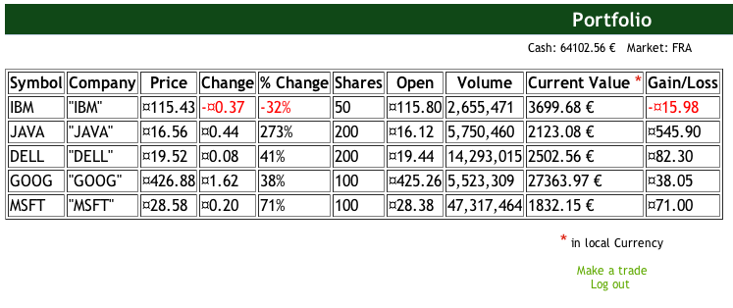
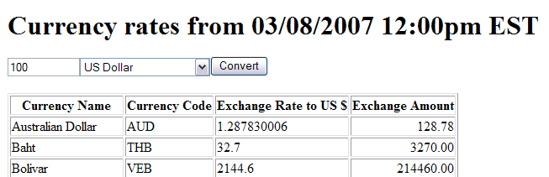
Formatting and Parsing – javax.money.format
Anatole Tresch
Introduction to JSR 354
http://java.net/projects/javamoney

Slide 26
Formatting and Parsing - Challenges
Anatole Tresch
Introduction to JSR 354
http://java.net/projects/javamoney
Multiple Locale instances for Translation, Dates, Time, Numbers, Currencies
Additional parameters, e.g. Currency Placement, Rounding, Lenient Fractions, Min, Max etc.
Natural language support for non-decimal valuations for example
  Lakhs, Crores (1 Lakh = 100,000, 1 Crore = 100 Lakh)
  INR 12,34,56,000.21 is written
  12 Crore, 34 Lakh, 56 Thousand
  Rupees and 21 Paise
How handle different formatting
styles?
public class LocalizationStyle
implements Serializable {
[…]
public String getId();
public Locale getTranslationLocale();
public Locale getNumberLocale();
public Locale getDateLocale();
public Locale getTimeLocale();
public Map<String, Object> getAttributes() ;
public <T> T getAttribute(
  String key, Class<T> type);
public boolean isDefaultStyle() ;
[…]
public static LocalizationStyle of(
Locale locale);
}
LocalizationStyle
ItemFormat
ItemFormatBuilder
MonetaryFormats Singleton

Slide 27
Formatting and Parsing (continued)
Anatole Tresch
Introduction to JSR 354
http://java.net/projects/javamoney
public interface ItemFormat<T> {
  public Class<T> getTargetClass();
  public LocalizationStyle getStyle();
  public String format(T item);
  public void print(Appendable appendable,
  T item)
  throws IOException;
  public T parse(CharSequence input)
  throws ParseException;
}
public interface FormatToken<T> {
public void print(Appendable appendable,
T item, LocalizationStyle s)
throws IOException;
public void parse(ParseContext<T> context,
LocalizationStyle style)
throws ItemParseException;
}
public class ItemFormatBuilder<T> {
private List<FormatToken<T>> tokens = new ArrayList<FormatToken<T>>();
[…]
public ItemFormatBuilder(){…}
public ItemFormatBuilder(Class<T> targetType){…}
public ItemFormatBuilder<T> addToken(FormatToken<T> token) {…}
public ItemFormatBuilder<T> addLiteral(String token) {…}
public boolean isBuildable() {…}
public ItemFormat<T> build() {…}
[…] }
Implementations:
LiteralToken
NumberToken
CurrencyToken
AmountToken
…

Slide 28

Currency Conversion – javax.money.conversion
Anatole Tresch
Introduction to JSR 354
http://java.net/projects/javamoney

Slide 29
Currency Conversion
Anatole Tresch
Introduction to JSR 354
http://java.net/projects/javamoney
ExchangeRateType
ExchangeRate:
  ExchangeRateType
  Base, Term currency
  Conversion factor
  Validity (from/until)
  Provider (optional)
  Direct/Derived Rates
ConversionProvider/CurrencyConverter
MonetaryConversions singleton
public interface ExchangeRate {
public ExchangeRateType getExchangeRateType();
public CurrencyUnit getBase();
public CurrencyUnit getTerm();
public BigDecimal getFactor();
public Long getValidFrom();
public Long getValidUntil();
public boolean isValid();
public String getProvider();
public List<ExchangeRate> getExchangeRateChain();
public boolean isDerived();
}

Slide 30
Currency Conversion - Usage
Anatole Tresch
Introduction to JSR 354
http://java.net/projects/javamoney
Simple Currency Conversion of an Amount
Money amount = …;
ConversionProvider provider = MonetaryConversion
.getConversionProvider(ExchangeRateType.of("EZB"));
CurrencyConversion chfConversion = provider.getConverter()
.getCurrencyConversion(MoneyCurrency.of("CHF"));
Money inCHF = amount.with(chfConversion);

Slide 31
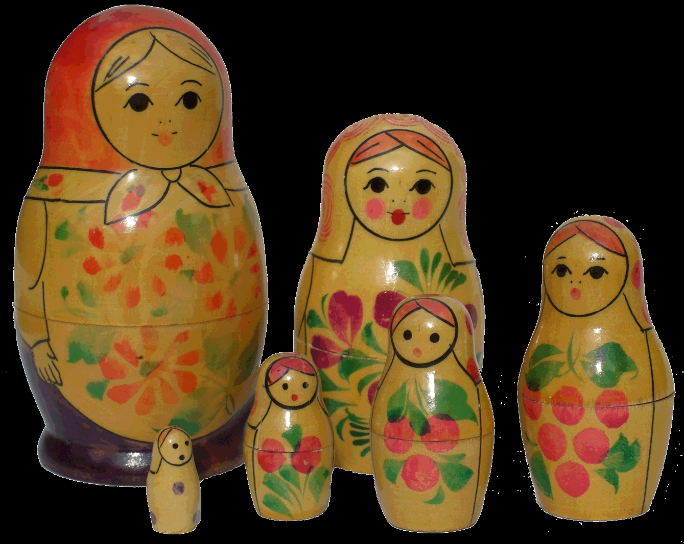
Currency Services & Extensions – javax.money.ext
Anatole Tresch
Introduction to JSR 354
http://java.net/projects/javamoney

Slide 32
Currency Services - MonetaryCurrencies
Anatole Tresch
Introduction to JSR 354
http://java.net/projects/javamoney
javax.money.MonetaryCurrencies singleton provides
  access to registered namespaces
  access to contained currencies within a namespace
  access to historic currencies
  Mapping of currencies between (or within) namespaces
public final class MonetaryCurrencies{
[…]
public static boolean isNamespaceAvailable(String namespace){…}
public static Collection<String> getNamespaces(){…}
public static boolean isAvailable(String namespace, String code, Long timestamp
public static CurrencyUnit get(String namespace, String code, Long timestamp)
public static Collection<CurrencyUnit> getAll(String namespace)
public static Collection<CurrencyUnit> getAll(String namespace, Long timestamp)
[…]
public static CurrencyUnit map(String targetNamespace, Long timestamp,
CurrencyUnit currencyUnit)
public static List<CurrencyUnit> mapAll(String targetNamespace, Long timestamp,
CurrencyUnit... units)
}

Slide 33
Extensions
Anatole Tresch
Introduction to JSR 354
http://java.net/projects/javamoney
Some Functionalities that may or may not be included with the JSR :
  Regions/Regional Providers,
  e.g. for mapping legal accepting
  currencies, legal tenders etc.
  …
Recent direction:
  If and what extensions are useful
  Some could be factored out into Extras (see next slide)

Slide 34
Extras
Anatole Tresch
Introduction to JSR 354
http://java.net/projects/javamoney
Additional Functionalities, not part of the actual JSR
  Multi-Currency
  Compound Values
  Statistical Modules
  Financial Modules
  CDI Extensions (e.g. via Apache DeltaSpike)
  JavaFX Bindings and Components
  …
Extras are provided as separate javamoney-extras GitHub repository
    What’s in for you, e.g. like javamoney-examples, no full JCP Membership is required to contribute there, contribute if you want/can…

Slide 35
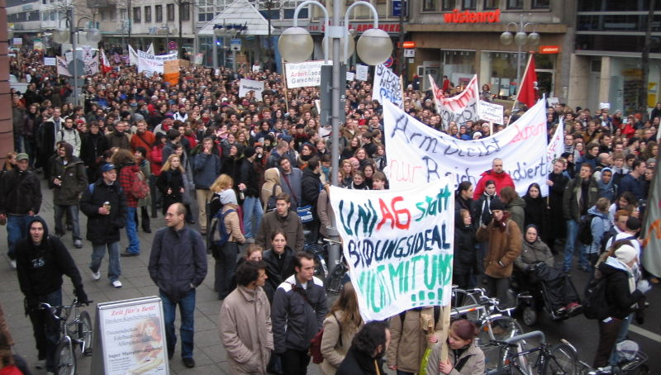
Demo
Anatole Tresch
Introduction to JSR 354
http://java.net/projects/javamoney

Slide 36
Stay Tuned
Anatole Tresch
Introduction to JSR 354
http://java.net/projects/javamoney
JSR 354: http://jcp.org
Java.net Project: http://java.net/projects/javamoney
GitHub Project: https://github.com/JavaMoney/javamoney
Twitter: @jsr354
Personal:
  Twitter: @atsticks
  atsticks@java.net

Slide 37
Q & A
Anatole Tresch
Introduction to JSR 354
http://java.net/projects/javamoney
???

Slide 38
The End
Anatole Tresch
Introduction to JSR 354
http://java.net/projects/javamoney
Thank you!

